Slide 1
21COP511: AI & Big Data Coursework
B720039

Slide 2
Task 1: Industry and research talk report

Slide 3
IBM –An Introduction to AI/ML Richard Hopkins
Overview – Gives a brief History of AL, and application of AI and ML. Various successful AI projects throughout history.
Discussion
- Really enjoyable presentation led by a very engaging and knowledgeable presenter. There was a lot of very fascinating projects that were highlighted in this presentation. Some of my favourites were as following
- Deep Blue – This was an artificial intelligence system that beat world champion Grand Master Kasparov. This was an amazing feat that was achieved in 1997. This was done by a powerful computer, whose evaluation functions were accomplished by training from previous games and analysing 1000+ grandmaster games. So, It was learning chess, not just beating Kasparov by brute strength and computational power.
- Project Debater – Which writes and outputs a speech writing by itself in an Oxford style debate. It listens and responds accordingly. This was interesting because it was up against a world champion debater, although it lost, I found it fascinating that it can understand a human and write and output a full speech to construct a flowing debate to try and win the audience. It lost because it lacks human emotions and is too factually base .
-

Slide 4
AI in Food Manufacturing Mohamad Saada
Overview – Highlights how Loughborough is in cooperation with Millitec, and shows how robots are being used in a sanitary fashion to reduce human labour.
Discussion
- A lot of technical aspects were discussed in this presentation. Main point was depth learning imagery which the robots use to create a 3D image of the food passing on a conveyer belt.
- I found it fascinating that even with all the technology it is costing money and a lot of time to gather data for the machine learning to overcome simple problems that were highlighted. For example, the system detects touching objects as a single item even if it is a small bit touching. This depth-based solutions were poor performers, especially when more than one ingredient is used.
- Deep learning being the solution was quite interesting, which ideally only reacts when it has identified the object through learning from a lot of models and training data. This gave very good results and the sandwiches looked much cleaner. The HDR production line produces 750000 sandwiches every day, that was cool fact to know.

Slide 5
Computacenter and NVIDIA (Multiple Speakers)
Overview – Talk about life of a data scantiest. Big Bang of Metaverse/ Omniverse, Hardware software and GPU from NVIDIA
Discussion
- Very interesting talk. Found it interesting talking about the hardware and graphics cards and the manufacturing and availability of them. Interesting how they are approaching to use severs instead of developing new devices for gaming.
- Most fascinating was talk about the Omniverse and the smart AI from project TOKKIO. I found it very captivating that the avatar can understand speech and reply, and retain information of what was being asked without prompting any hints at it. It also does gestures that follow the speech.
- Also interesting learning about software used for analysis of real life situations. They use real time physics in the omniverse that generates real life incidents and motion of objects like explosion, flowing and basic physics.

Slide 6
Fujitsu Jensen Deutrom
Overview – Highlights history of Big Data, and problems with Big Data. Also give applications of Big Data and how it can be helpful such as Cyber Security
Discussion
- I found this interesting because it shows that there are a lot of problems data scientists, analysts, miners face. Some can influence and change how the data is being used and should be used. It is interesting that clients can ask for specific things, but this can be misinterpreted which can lead to problems.
- The cyber security was the most interesting aspect. Big Bata can be used to for advanced threat detection. The real-time gathering of data allows quick response and accelerated e the threat detection and ‘identify the attack early on in the kill chain and minimise the damages.
- I also found how Big Data is being used for National Security, this was done by tweet analysation and other social networking. This allows the analysts to trigger threat alerts in advance. However there limitations of it which includes language.

Slide 7
IBM Mary Wallace
Overview – Use of Data science in business, mapping out a business. Innovation of current available products and systems.
Discussion
- Enjoyed discussion on the metaverse. Gave insight how the Metaverse can be used for business and e-commerce, with different companies, and sales being done over different reality or digital reality, she also gave various other opportunities for the metaverse. Learned what needs to change when approaching to open a business in the metaverse
- Learning about decentralisation which his beneficial personally as my final project is on NFT and Cryptocurrency. Highlighted how metaverse and NFT can be used in the future, such as owning an NFT give client various assets, and finding ways to attract customer in the metaverse

Slide 8
Task 2: Data Analysis and Visualisation of Health data
Exploring Global Maternal Mortality Using Tableau

Slide 9
Objectives
Identify regions where most maternal mortality have occurred
Show trend of mortality periodically
Compare countries off different regions
Show visual understanding of global maternal mortality ratios
Identify some underlying causes of high mortality

Slide 10
Data Compilation
Maternal Mortality
Maternal Mortality Rate
Birth Attendance by Skilled Professional
Antenatal Care
These datasets were compiled together matching by country and time period. These closely relate to one another and conclusions can be drawn from each other and accomplish the listed objectives.

Slide 11
Dataset
All the data sets contain
Country
Year (period)
The other Fields used were :
Maternal Mortality count – this was shown with the death of mothers after birth in individual time periods.
Maternal Mortality Rate – this was a count given periodically, showing the deaths of mother per 100000 live births. This helps with comparisons of countries with vast population compare to smaller ones.
Antenatal Care Coverage (ANC) – this was given as a percentage of mothers visiting medical facilities at least 4 times during labour period, for check ups.
Supervision of Skilled Professional – this was given as a percentage of mothers having access to a professional who aids before, during and after child birth.

Slide 12
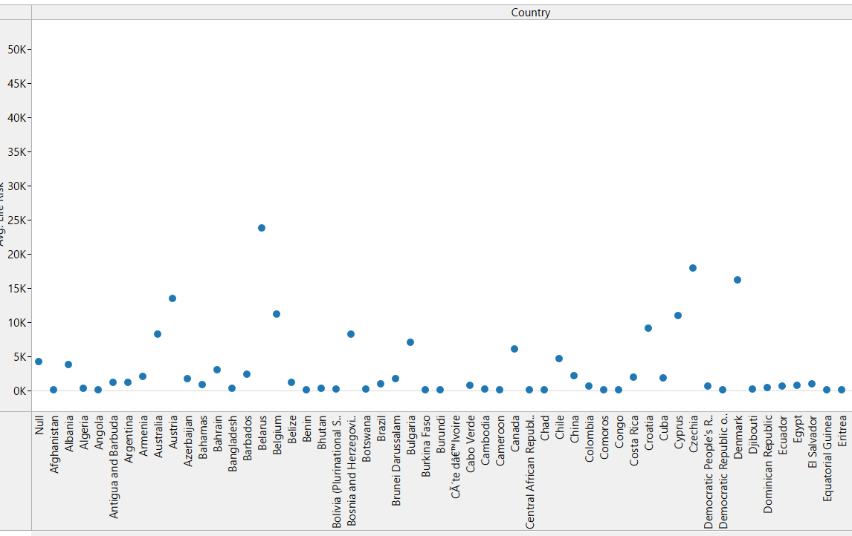
Cleaning Data
As various data sets were compiled together it was inevitable there was missing data, and not all time period were covered in each data set. There fore to remove this Tableau was uses appropriately during individual investigations. Where the data set is incomplete like for Antenatal Care, inner join is used so only full data is used.
Scatterplots were made initially before the investigation began, that gave an insight into the dataset. This shows rough distribution and if there are any outliers of missing data.

Slide 13
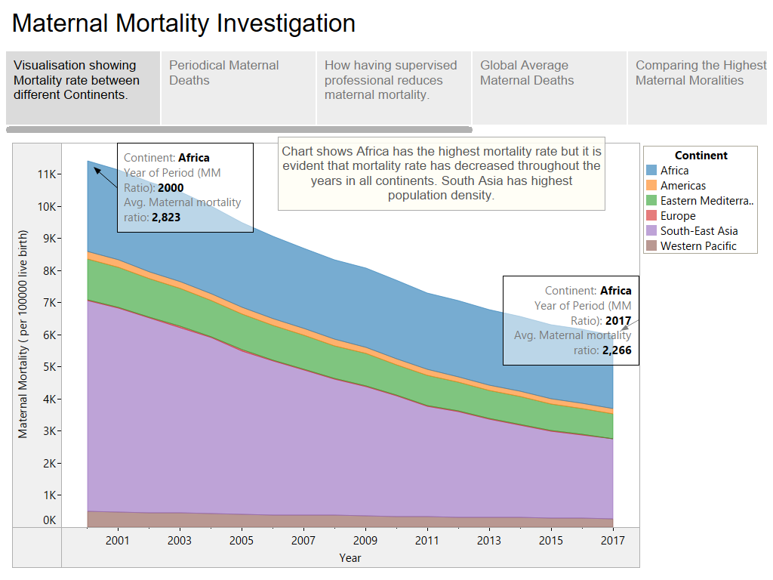

Slide 14
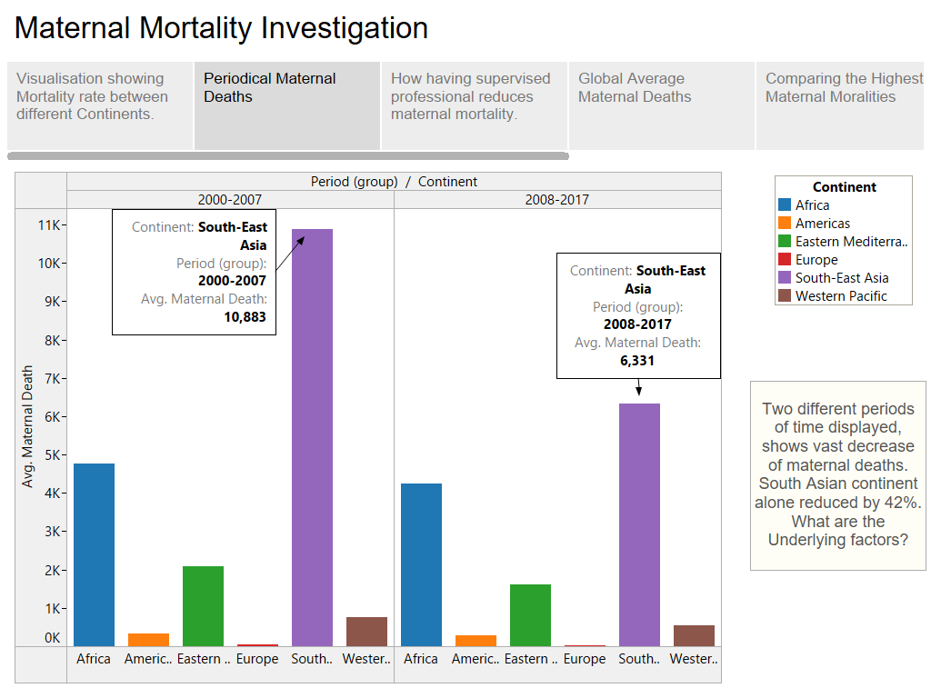

Slide 15
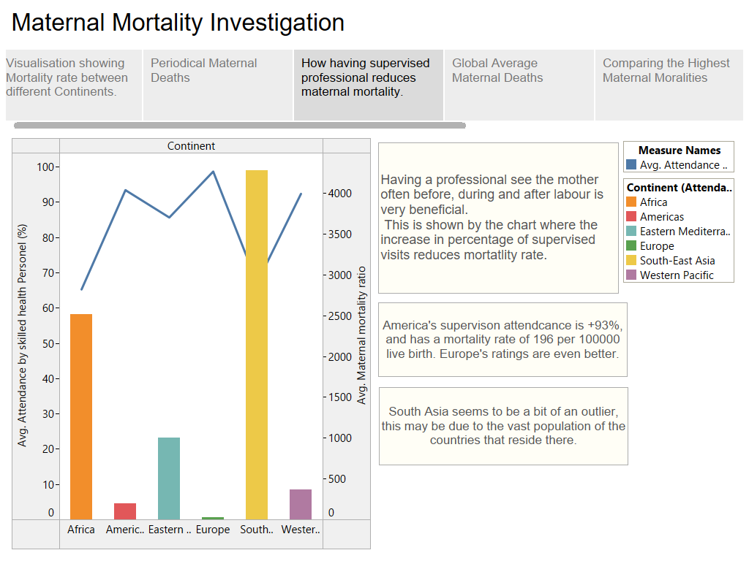

Slide 16
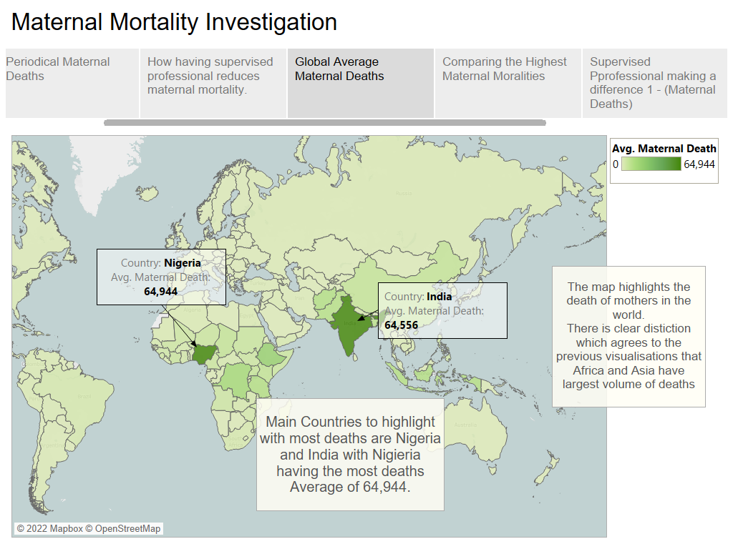

Slide 17
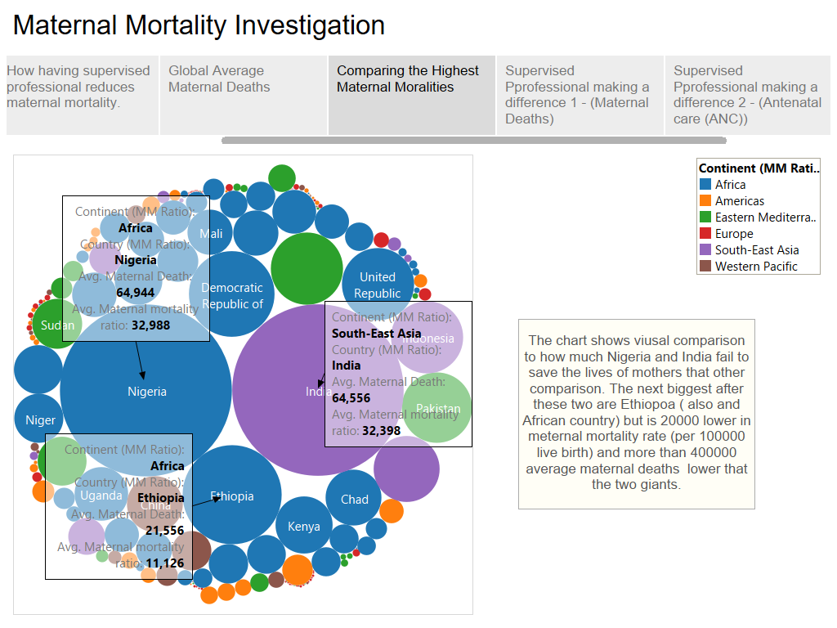

Slide 18
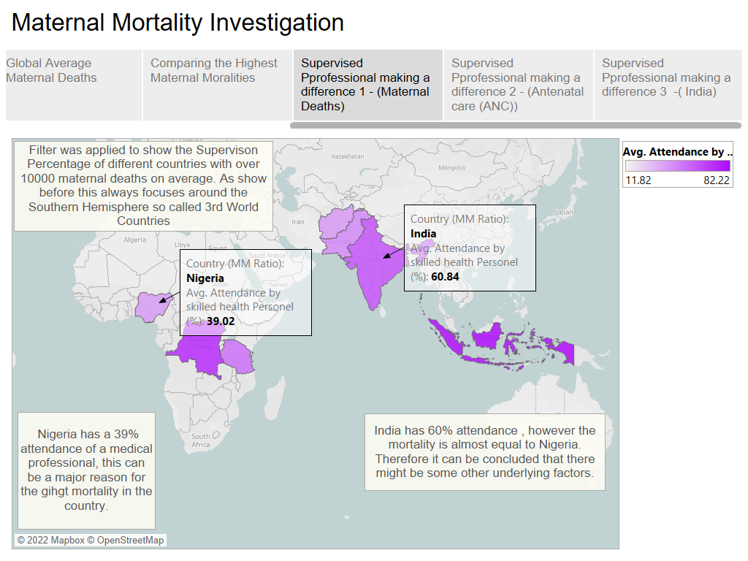

Slide 19
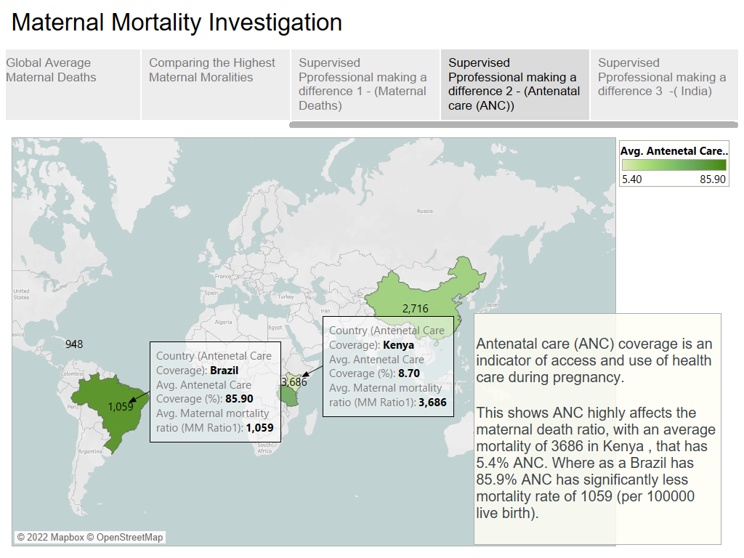

Slide 20
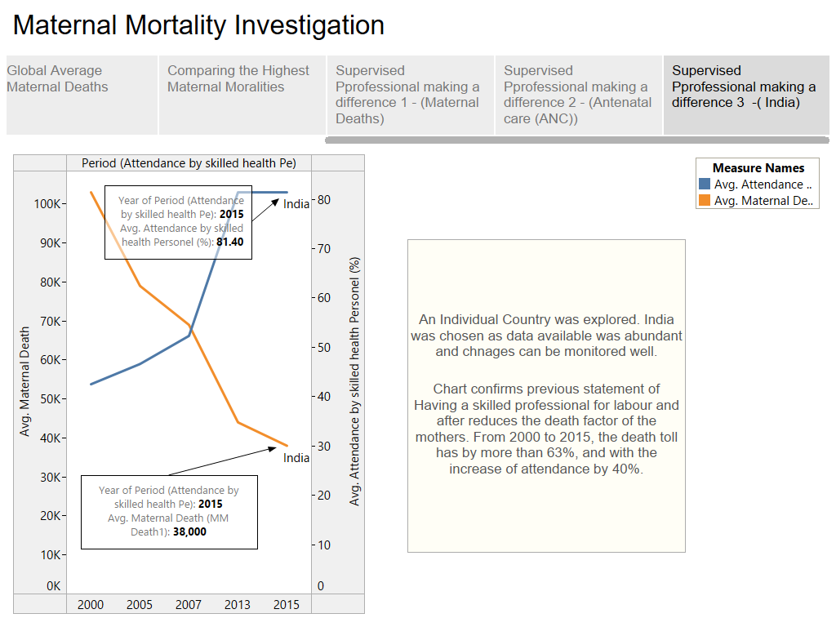

Slide 21
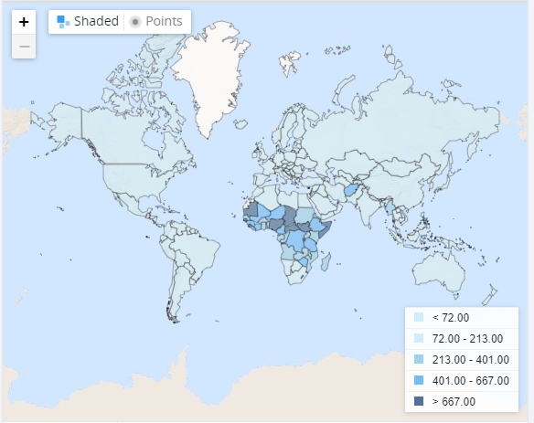
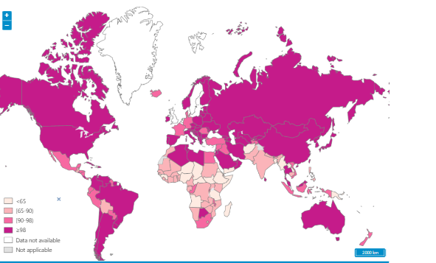
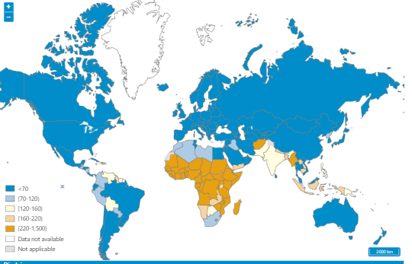
Media
The two figures are taken from WHO webpage about Maternal deaths. These seem to roughly agree with the finding of this investigation.
The first highlights the scare attendance of skilled professionals in 3rd World countries like India and a lot on the African Continents. This is then concludes the hypothesis of having larger maternal deaths. This is also show by the figure below that highlights the strong death count in the yellow highlighted regions portraying Africa and South Asian Communities.
Attendance of Skilled Professional from WHO
Maternal Mortality ratio model by THE WORLD BANK
The investigation can have even more credibility with this snapshot from the World Bank, that have modelled maternal mortality rate per 100000 live births. This gives very similar results to the ones provided in the Tableau story above. High death density in African regions and some in South Asian.
Mortality Rate from WHO
Notes:
Who.int. 2022. Number of maternal deaths. [online] Available at: <https://www.who.int/data/gho/data/indicators/indicator-details/GHO/number-of-maternal-deaths> [Accessed 27 May 2022].
Data.worldbank.org. 2022. Maternal mortality ratio (modeled estimate, per 100,000 live births) | Data. [online] Available at: <https://data.worldbank.org/indicator/SH.STA.MMRT?end=2017&start=2017&view=map> [Accessed 27 May 2022].

Slide 22
Conclusion
Discussion – (references the story)
Visualisation showing Mortality rate between different Continents.
This gave insight to population density and of maternal mortality throughout the different continents.. Gave clear evidence that Africa had higher mortality rate and South Asia had more density of deaths each year.
-Periodical Maternal Deaths
The next investigations shows that there is a creasing tend in mortality through the years as civilisation is becoming more modernised. This gives hints that during earlier years the African continent and South Asian region were developing and are still developing unlike America and Europe which can be classed as developed. Developing countries lack proper healthcare, and have high prevalence infectious diseases, plus higher fertility rate.

Slide 23
-How having supervised professional reduces maternal mortality
This investigates external factors that can influence the maternal death rate of countries and continents. As it is shown that lack of medical care and professional carers can heavily influence the rise in death count.
- Global Average Maternal Deaths
This compared two countries with the largest average maternal death rate, and they fall within the developing countries.
Comparing the Highest Maternal Moralities
When comparing all other countries it is very event that the highest death rates fall under Africa and Asia again, all the significant bubbles shows are highlighted as such.

Slide 24
Supervised Professional
From the investigations it has shown that a higher percentage of mothers survive when a skilled professional is aiding them before, during or after child birth. And the Maps show that high attendance is only available in the developed regions such as Europe and America. This can be one of the underlying factors of the mortality rates and investigation.
Another would be the economy itself, the loss of mothers affects the economy of countries heavily as mother are dying while being in their prime (most) , they are not adding much value to the economy therefore progress of development is rather slow. This can be drawn back to why Africa and South Asian are still developing countries, they are falling behind due to high mortality rate, which ruin economy which in turn means no development of medical apparatuses, appropriate atmosphere for medical attention of even proving enough skilled professionals for a mother.

